Slide 1






SKILL DEVELOPMENT LAB PROJECT
MOVIE WEBSITE USING BOOTSTRAP
PRESENTED
BY
G Bhavya Bhargavi - 227R1A05E4
B.Deepthi - 227R1A05D4
Balaji Nayak- 227R1A0D2

Slide 2



MOVIE WEBSITE USING BOOTSTRAP
Description:
The "Top 5 Movies List with Ratings" project is an aesthetically pleasing and responsive web application built with Bootstrap, designed to showcase a curated list of top-rated movies. This project combines the power of Bootstrap's front-end framework with movie data, creating an engaging user interface that dynamically displays movie titles and ratings.

Slide 3


KEY FEATURE
Responsive Design with Bootstrap:
Utilizing Bootstrap, the project ensures a responsive and visually appealing layout that adapts seamlessly to various screen sizes and devices.
Dynamic Movie List:
The web application dynamically generates and displays a list of the top 5 movies. Movie titles are accompanied by their respective ratings, creating an easy-to-read and informative display.

Slide 4

Interactive User Interface:
Bootstrap components are leveraged to create an interactive and user-friendly interface. Users can navigate the movie list effortlessly, experiencing a smooth and enjoyable browsing experience.
Rating System Integration:
Each movie entry includes a rating, providing users with an at-a-glance indication of the movie's popularity or critical acclaim. Ratings may be displayed using stars or a numerical system for clarity.
Mobile-Friendly Layout:
The project ensures that the movie list and ratings are presented attractively on mobile devices, allowing users to access the content conveniently while on the go.

Slide 5

<!DOCTYPE html>
<html long="en">
<head>
<title>TOP 5 MOVIES LIST </title>
<meta name ="viewport"content ="width=device-width"initial-scale="1">
<link path>
<script src="path"></script>
<style>
body{
background-color: aqua;
}
</style>
</head>
<body>
<p>Top 5 Movies list in every language. By this list.<br>
We can easily identify the top and best movies which we like it.<br>
We can know this by rating.<br>
In this we can see a common movie BAHUBALI both in telugu in hindi movies.so that it's also known as a PAN INDIA MOVIE.
Code

Slide 6


</p>
<div class ="container">
<img src="path" class=" ">
</div>
<div class="container">
<ul class="nav">
<li class ="nav-item"><a class ="nav-link" href="bootstrap.html">MOVIES</a></li>
<li class ="nav-item"><a class ="nav-link" href="hindi.html">HINDI MOVIES</a></li>
<li class ="nav-item"><a class ="nav-link" href="telugu.html">TELUGU MOVIES</a></li>
<li class ="nav-item"><a class ="nav-link" href="international.html">INTERNATIONAL MOVIES</a></li>
<li class ="nav-item"><a class ="nav-link" href="anime.html">ANIME MOVIES</a></li>

Slide 7
The code will be same but the pages were different,style,border,design,images etc are different and remaining code will be same .
So same format we’ll use in remaining pages too HERE it displays top 5 movies and its rating etc , price etc details .
AND The 1st page Movies
2nd page telugu movies
3rd page hindi movies
4th page international movies
5th page anime movies
6th page taylor movies
At last by using all features of bootstrap we creating a website.

Slide 8
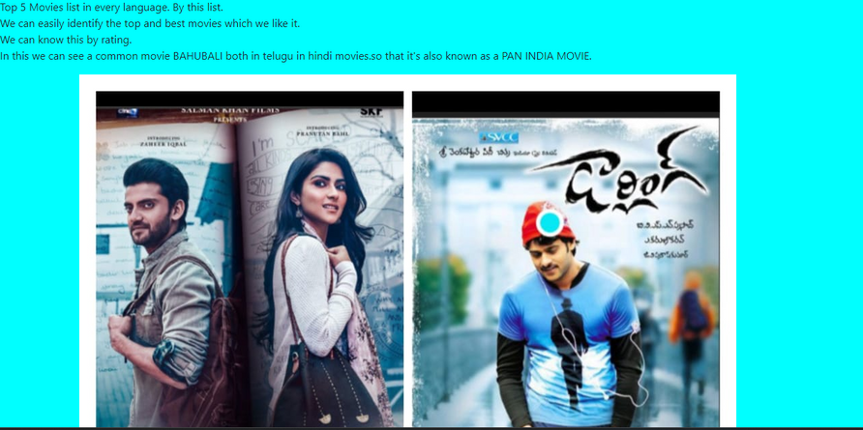
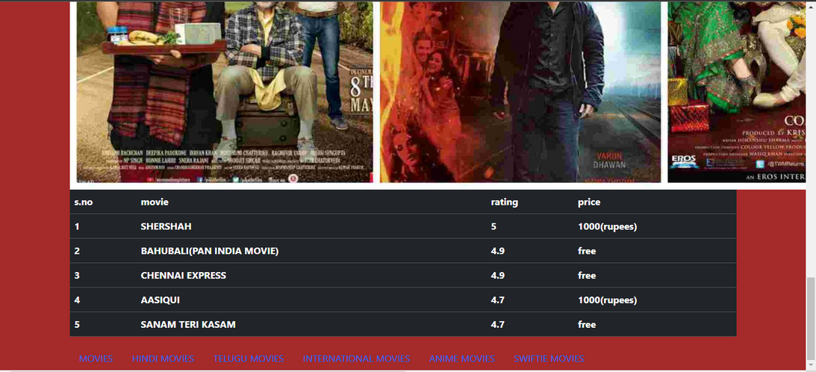
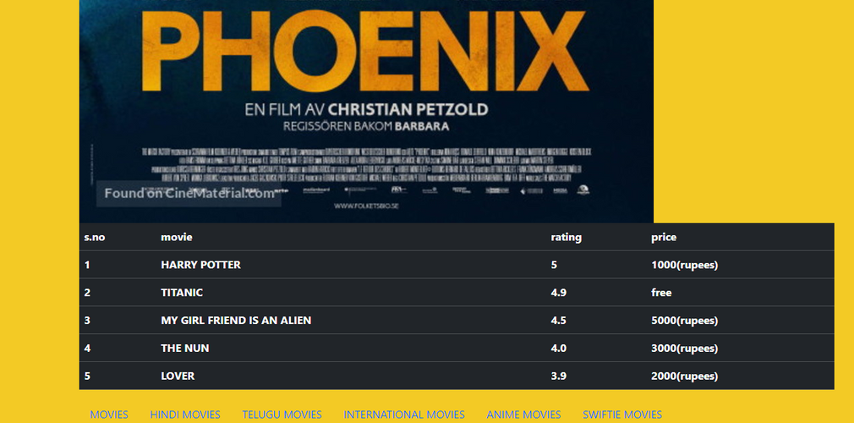
OUTPUT

Slide 9
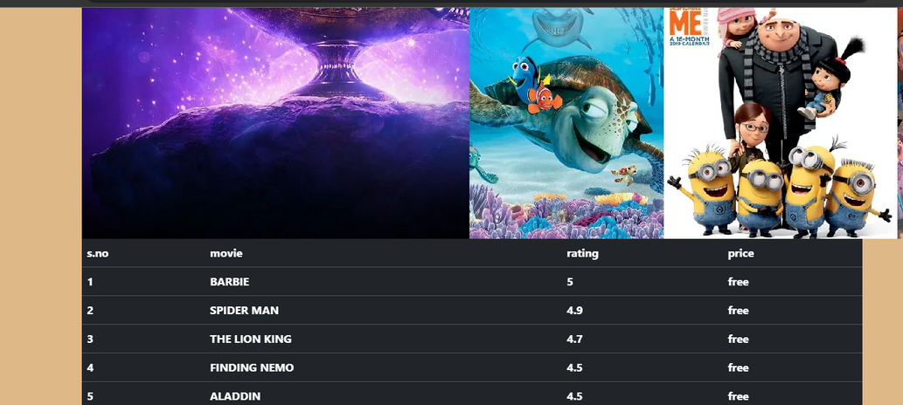

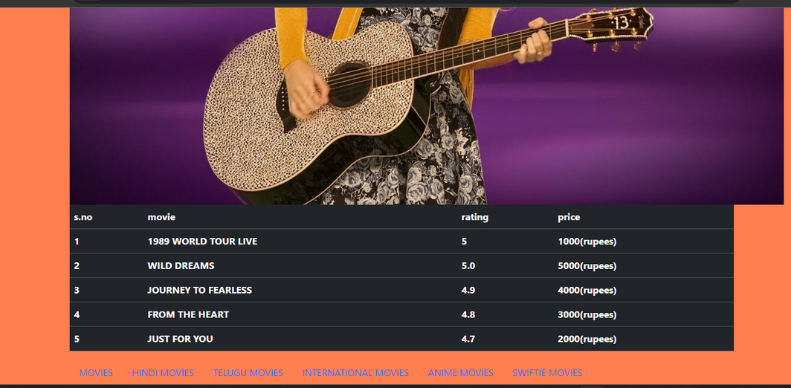

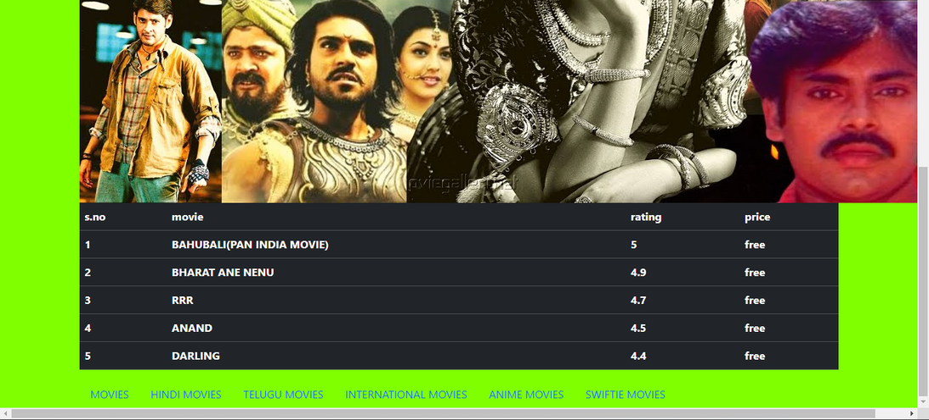
Product 1
Product 3

Slide 10
Thank You

